Slide 1
Binary Decoder
Black box with n input lines and 2^{n} output lines
Only one output is a 1 for any given input
Binary
Decoder
n
inputs
2^{n} outputs

Slide 2
Overview
Binary Decoders
  Converts an n-bit code to a single active output
  Can be developed using AND/NAND gates
  Can be used to implement logic circuits.

Slide 3
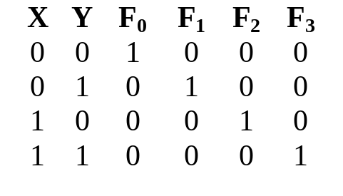
2-to-4 Binary Decoder
Truth Table:
F₀ = X'Y'
F₁ = X'Y
F0
F1
F2
F3
F₂ = XY'
X
Y
2-to-4
Decoder
F₃ = XY
From truth table, circuit for 2x4 decoder is:
Note: Each output is a 2-variable minterm (X'Y', X'Y, XY' or XY)
X
Y

Slide 4
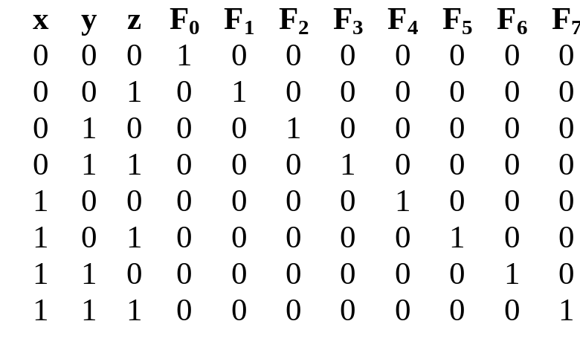
3-to-8 Binary Decoder
Truth Table:
F₀ = x'y'z'
F₁ = x'y'z
F₂ = x'yz'
F₃ = x'yz
F₄ = xy'z'
F₅ = xy'z
F₆ = xyz'
F0
F1
F2
F3
F4
F5
F6
F7
F₇ = xyz
X
3-to-8
Decoder
Y
Z
x
y
z

Slide 5
Implementing Functions Using Decoders
Any n-variable logic function can be implemented using a single n-to-2^{n} decoder to generate the minterms and using the OR gates.
Any combinational circuit with n inputs and m outputs can be implemented with an n-to-2^{n} decoder with m OR gates.
Suitable when a circuit has many outputs, and each output function is expressed with few minterms.

Slide 6
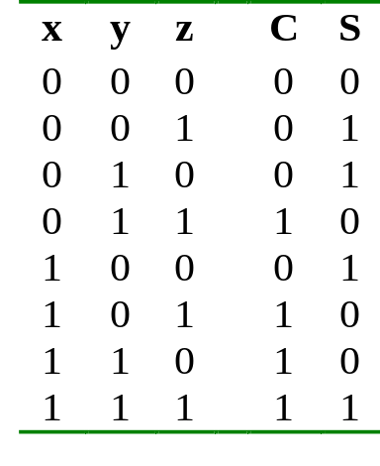
Implementing Functions Using Decoders
Example: Full adder
  S(x, y, z) = Σ (1,2,4,7)
  C(x, y, z) = Σ (3,5,6,7)
3-to-8
Decoder
0
1
2
3
4
5
6
7
S
x
S₂
S₁
S₀
y
z
C

Slide 7
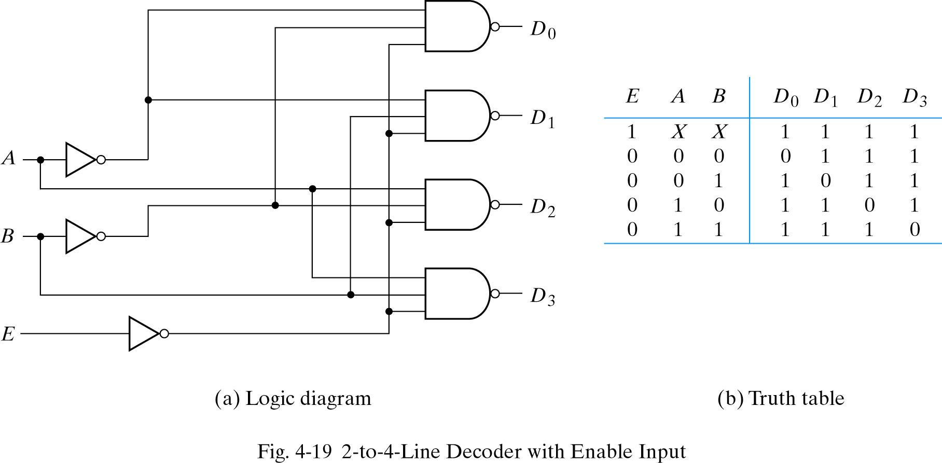
Building a Binary Decoder with NAND Gates
Start with a 2-bit decoder
  Add an enable signal (E)
Note: use of NANDs
only one 0 active!
if E = 0

Slide 8
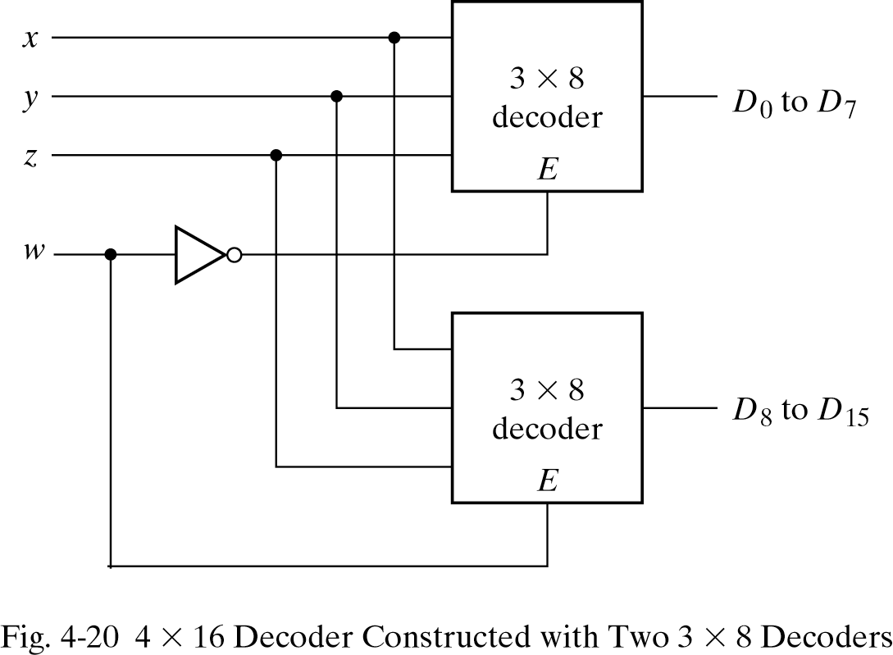
Use two 3 to 8 decoders to make 4 to 16 decoder
Enable can also be active high
In this example, only one decoder can be active at a time.

